Slide 1
Approach for Sensitivity Analysis
84 candidate variables for screening
34 candidate variables for sensitivity analysis
down-selection
Elementary-Effects Screening
Identifies variables that may have significant influence on results, singly or in combination with other variables
Morris method
One-at-a-time (OAT) experimental design
5 levels for each variable
500 repetitions (OAT trajectories)
42,500 simulations total
Variance-Based Sensitivity Analysis
Verifies and quantifies the influence of each variable on the results, singly and in combination with other variables
Sobol’/Satelli method
Quasi-random series for experimental design
2500 point per variable
4 base cases
85,000 simulations per case

Slide 2
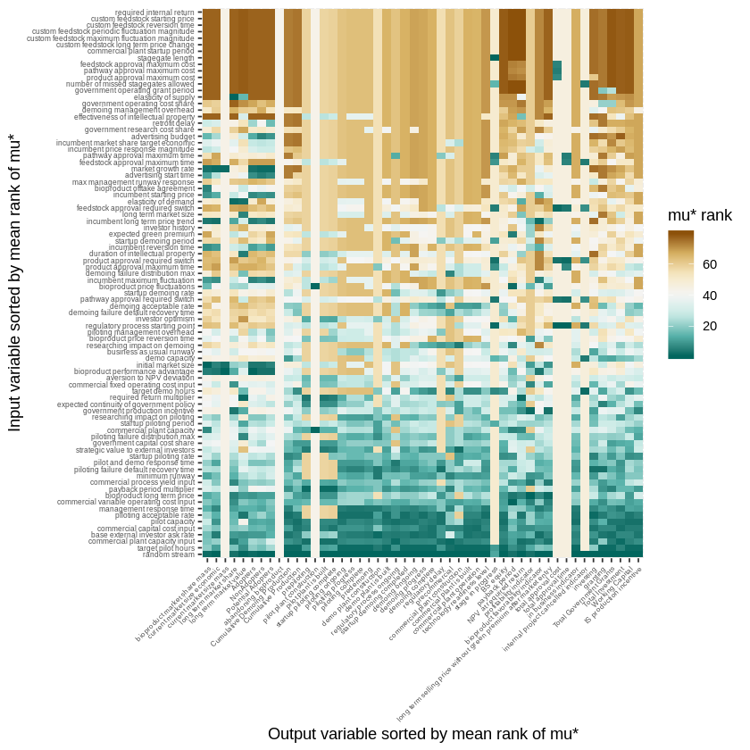
Elementary Effects
Lower rank indicates that a variable is more influential.
A variable may be influential for some output metrics, but not for others.
Some variables are influential for all output metrics.
Some output variables are not heavily influenced.

Slide 3
Sensitivity analysis indicates that no single variable can move development beyond the “Valley of Death” by itself, but combinations of variables move development in concert.
Low sensitivity alone
High sensitivity together
PRELIMINARY RESULTS SUBJECT TO REVISION

Slide 4
Decision-Tree Analysis for Influence of Variables
The percentages indicate the fraction of the scenarios with successful commercial development.
The conditions (branches) map the path through the “Valley of Death”.
Target Pilot Hours
high
low
Required Return
Startup Piloting Rate
low
high
Research Impact on Piloting
Long-Term Price
low
high
72%
Expected Continuity of Gov’t Policy
low
high
low
high
Target Pilot Hours
13%
91%
high
low
Piloting Acceptable Rate
63%
lower
higher
6%
52%
Replacement
high
low
direct
advantaged
1%
Commercial Plant Capacity
Scale
85%
high
low
commodity
niche
PRELIMINARY RESULTS SUBJECT TO REVISION
1%
61%
4%
85%

Slide 5
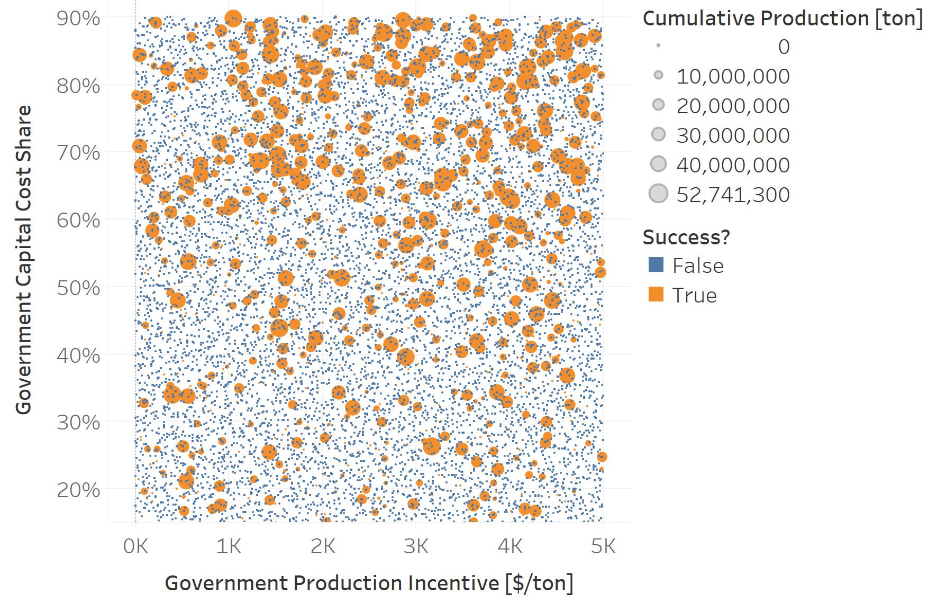
Capital vs Production Incentives
Capital cost shares tend to influence success more strongly than production incentives.
Many other factors influence the outcome.
PRELIMINARY RESULTS SUBJECT TO REVISION

